Slide 1
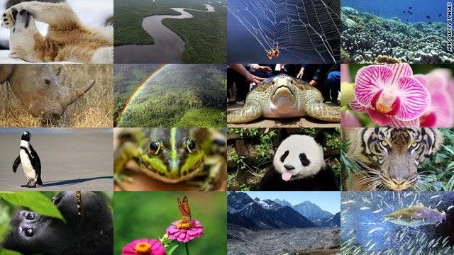
Calculating Biodiversity Index

Slide 2
Biodiversity Index
Scientists use a formula called the biodiversity index to describe the amount of species diversity in a given area.
There are different ways to measure diversity

Slide 3
Simple Calculation
A simple biodiversity index is calculated as follows:
Number of species in the area (numerator)
-----------------------------------------------------------------------
Total number of individuals in the area (denominator )

Slide 4
Example 1 - CORN
For example, a 10x10 meter square area in a corn field patch has 300 corn plants, all the same species.
Number of species in the area (numerator)
-----------------------------------------------------------------------
Total number of individuals in the area (denominator )
It has a very low biodiversity index of 1/300, or 0.003.

Slide 5
Example 2 - FOREST
A 10x10 meter square area in the forest has 1 pine tree, 1 fern, 1 conifer tree, 1 moss, and 1 lichen, for a total of 5 different species and 5 individuals.
Number of species in the area (numerator)
-----------------------------------------------------------------------
Total number of individuals in the area (denominator )
The biodiversity index here is 5/5 = 1.

Slide 6
Simpson’s Index
Simpson’s Index includes:
Species Richness: The total number of species in an area.
Species Evenness: How evenly the species are represented. Do most of the individuals belong to just one species?

Slide 7
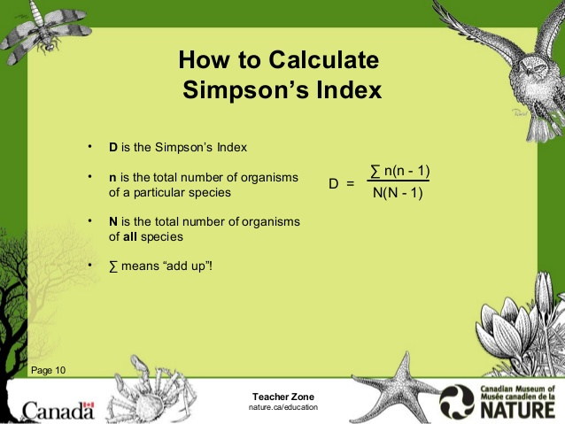
Simpson’s Index

Slide 8
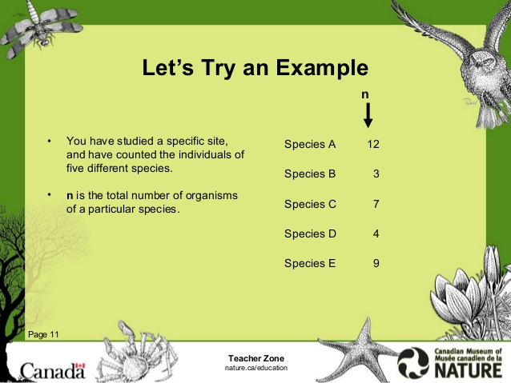
Simpson’s Index

Slide 9
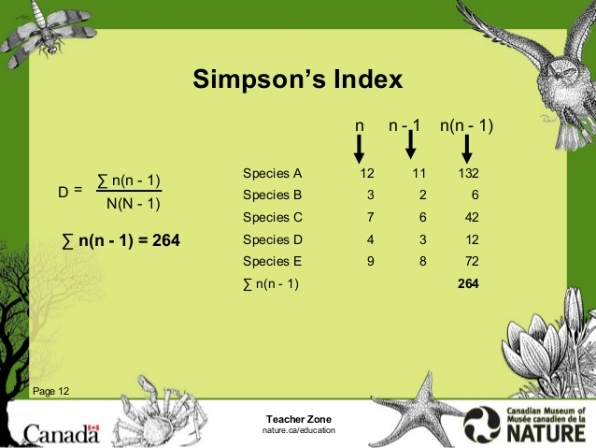
Simpson’s Index

Slide 10
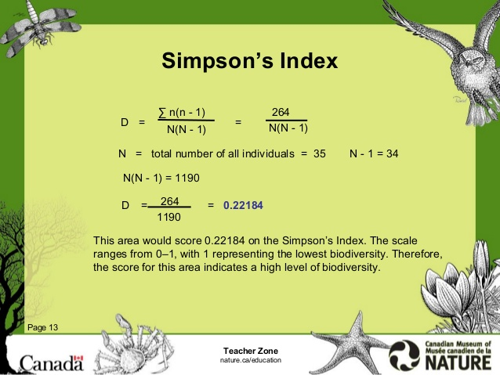
Simpson’s Index

Slide 11

Simpson’s Index

Slide 12
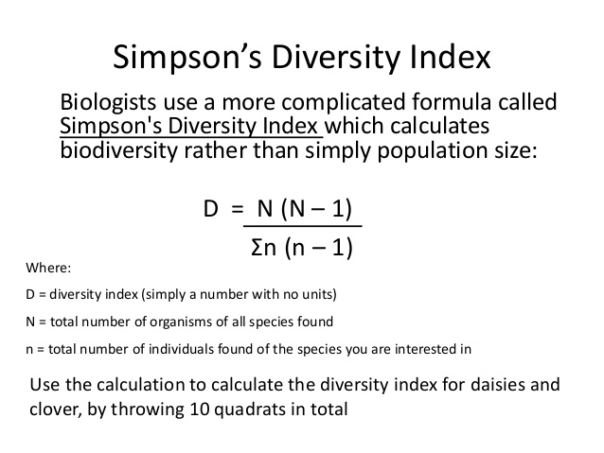
Simpson’s Index
Click on this link to review some more examples

Slide 13
Simpson’s Index

